Slide 1


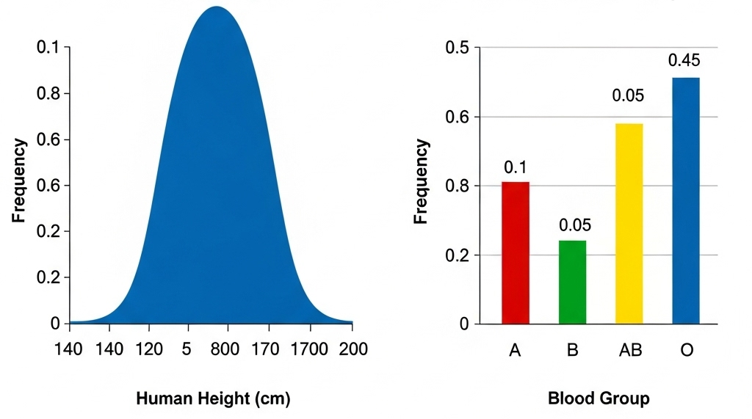
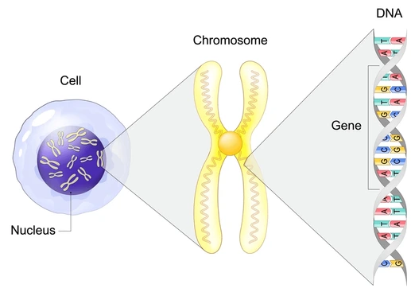
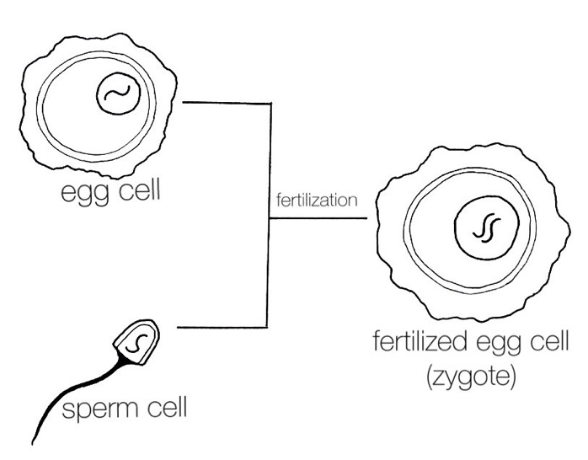

As you come in…
Variation |  | a. Which graph shows continuous variation? b. Which graph shows discontinuous variation? c. Give one genetic cause of variation and one environmental cause.
Chromosomes, Genes & DNA |  | a. What is the shape of DNA called? b. Which bases pair together? c. How many pairs of chromosomes are in a human cell? d. What is a gene and what does it code for?
Gametes |  | a.Why do gametes contain only 23 chromosomes? b. After fertilisation, why does the zygote have 46 chromosomes? c. What do we call different versions of the same gene?

Slide 2
Variation
a. Continuous variation → a smooth bell-shaped (normal distribution) graph (left).
b. Discontinuous variation → a bar chart with distinct categories (right).
c. Genetic cause → mutation / different alleles
Environmental cause → diet / climate.
Chromosomes, genes, DNA
a. Shape → double helix.
b. Base pairs → A–T and C–G.
c. Chromosome pairs → 23 pairs.
d. Gene → a section of DNA that codes for a protein.
Gametes
a. Gametes have 23 chromosomes so that chromosome number makes 46 after fertilisation
b. After fertilisation, zygote has 46 because chromosomes from sperm and egg combine.
c. Different versions of the same gene → alleles.

Slide 3
Inheritance
Not in your textbook
Lesson objectives
To explain that inherited characteristics are controlled by genes passed from parents to offspring via gametes
To describe the difference between dominant and recessive alleles using examples
To use genetic diagrams (Punnett squares) and pedigrees to predict inheritance patterns involving dominant and recessive alleles.
Keywords: gene, allele, dominant, recessive, genotype, phenotype, homozygous, heterozygous

Slide 4
Success Criteria
Working towards | Working at | Working beyond
I can explain that inherited characteristics are controlled by genes passed from parents to offspring via gametes. | I can describe the difference between dominant and recessive alleles using examples. | I can use genetic diagrams (Punnett squares) and pedigrees to predict inheritance patterns involving dominant and recessive alleles.
Inheritance

Slide 5
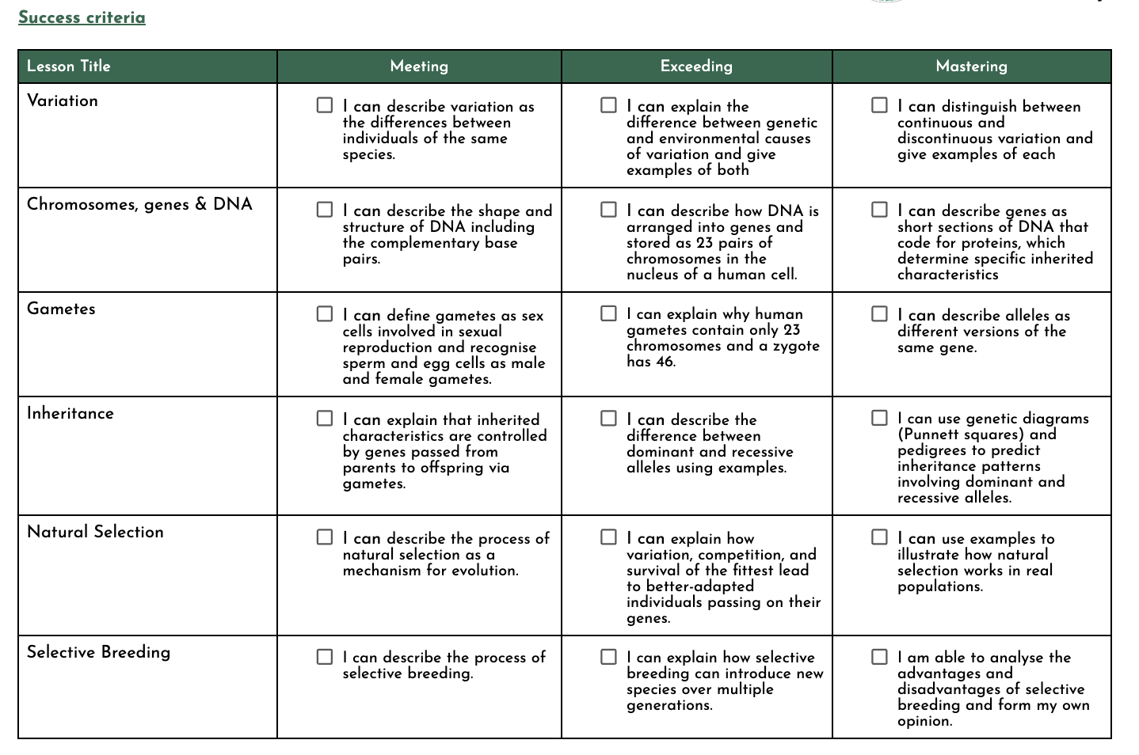

Slide 6
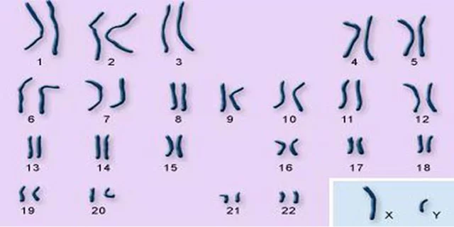

Does this set of chromosomes come from a male or female?
In most cells, chromosomes are matched in pairs based on their size and shape.
The 23rd pair of human chromosomes is special, these are called the _________
__________________. They control the ____ of the fetus .
sex
chromosomes
sex
Notes:
XX females XY males

Slide 7
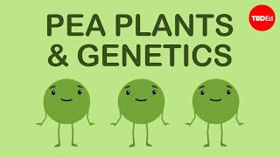
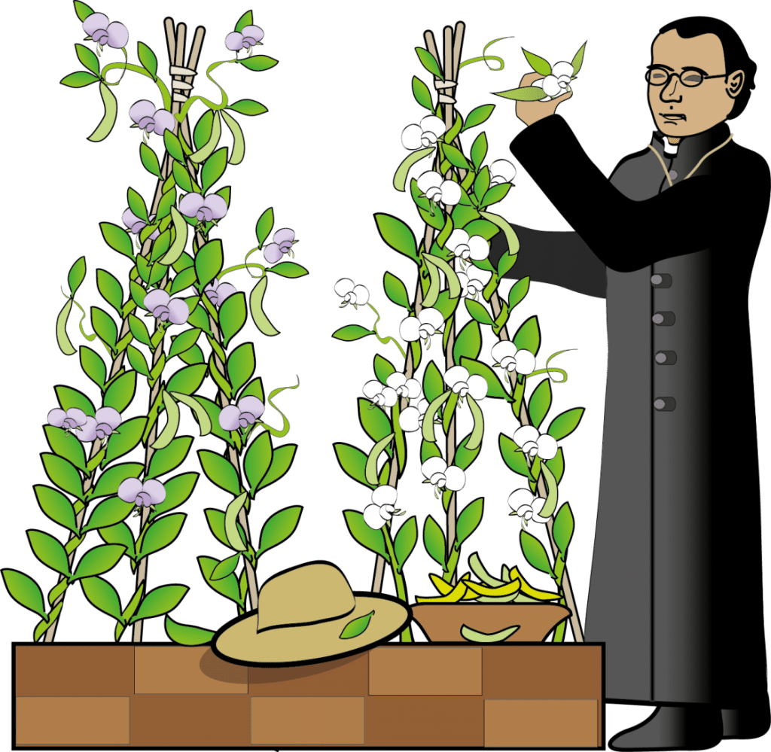
Gregor Mendel, through his work on pea plants, discovered the fundamental laws of inheritance.

Slide 8
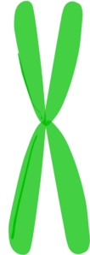
Allele = Different version of the same gene
Dominant = only needs 1 copy of the allele to display the characteristic
Recessive = needs 2 copies of a recessive allele to display the characteristic

Slide 9
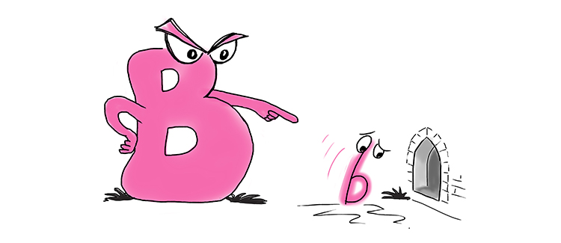
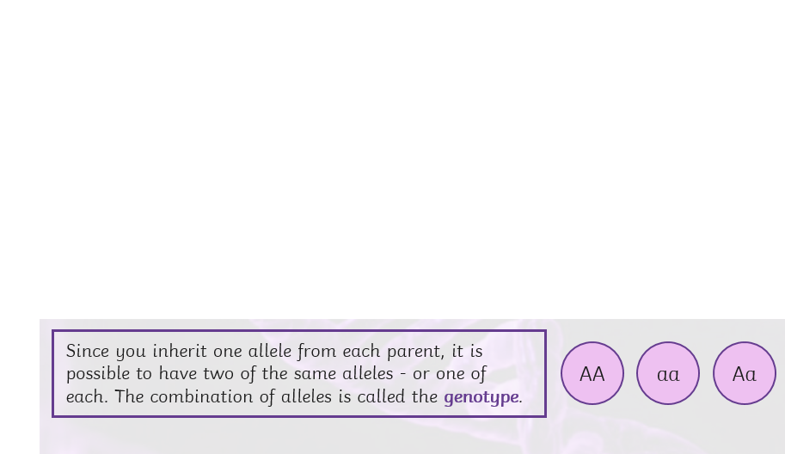
Genes are represented with a letter
Dominant = Capital (B)
recessive = lower case (b)
The dominant allele is expressed even if there is only one present.

Slide 10
Genotype – the combination of alleles a person has
Homozygous – when both alleles a person has are the same
Heterozygous - when a person has two different alleles for the same gene
Phenotype – the physical appearance of someone based on their genotype
What are the genotypes and phenotypes for these individuals?

Slide 11
Genotype – the combination of alleles a person has
Homozygous – when both alleles a person has are the same
Heterozygous - when a person has two different alleles for the same gene
Phenotype – the physical appearance of someone based on their genotype
Heterozygous
Genotype: Bb
Phenotype: Brown eyes
Homozygous dominant
Genotype: BB
Phenotype: Brown eyes
Homozygous recessive
Genotype: bb
Phenotype: Blue eyes

Slide 12

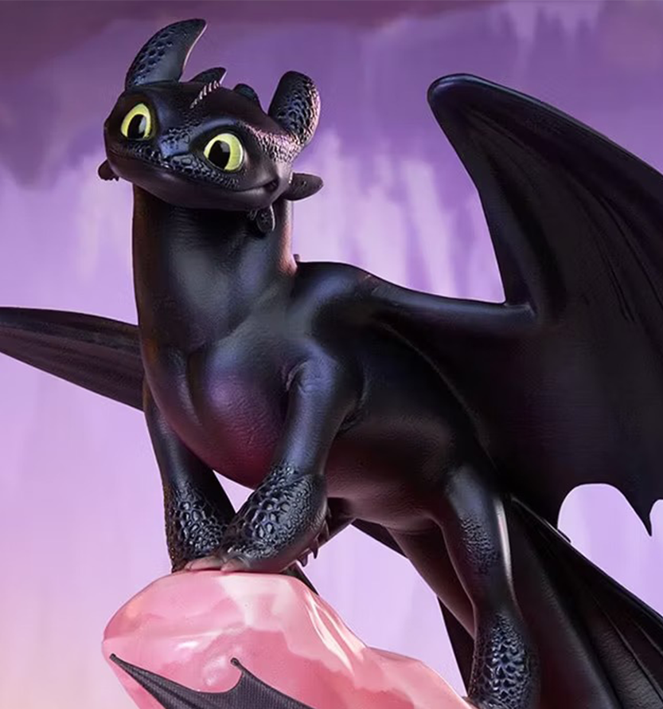
Starter
F = Fire-breathing allele (Dominant)
f= Non-fire-breathing allele (Recessive)
Please write this in your books (only answers!)
The genotype of a dragon that has two different alleles.
Is this dragon heterozygous or homozygous?
What is this dragon's phenotype? Will it breathe fire?
What is the only genotype that produces a non-fire-breathing dragon?

Slide 13
Starter
F = Fire-breathing allele (Dominant)
f= Non-fire-breathing allele (Recessive)
Please write this in your books (only answers!)
The genotype of a dragon that has two different alleles.
Is this dragon heterozygous or homozygous?
What is this dragon's phenotype? Will it breathe fire?
What is the only genotype that produces a non-fire-breathing dragon?
Ff
heterozygous
Yes, fire-breathing
ff

Slide 14
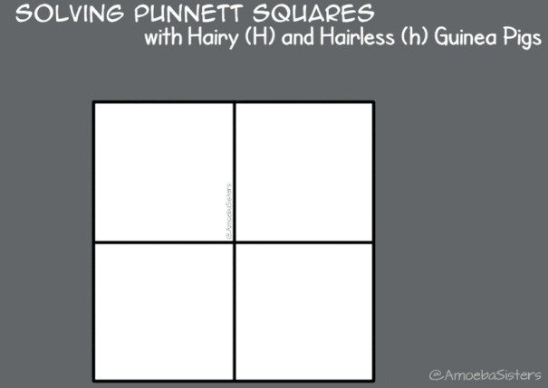
A genetic diagram shows how chromosomes or alleles may combine in zygotes.

Slide 15
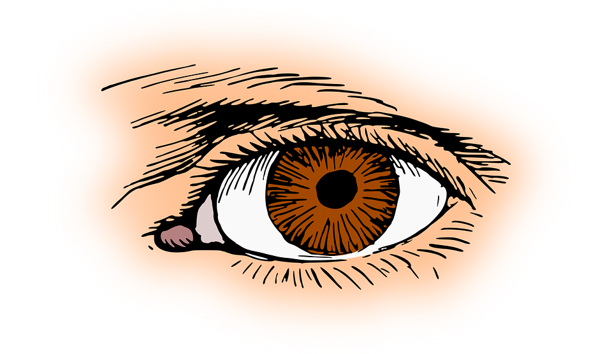
Inheritance
Practise how to draw a Punnett square to show single gene inheritance.
Step 1 First, draw a grid with 4 squares | Step 2 Put the possible gametes (eggs and sperm) from one parent down the side, those from the other parent along the top. | Step 3 Then in each middle square, fill the letters from the top and the side that line up with the square - the pairs of letters show the possible combination of gametes. | Finished diagram
✔
Female gametes
B b
B b
B b
B
B
B
BB | Bb
Bb | bb
BB
Male gametes
b
b
b
Q1: What is the probability of getting a child with brown eyes?
Heterozygous (Bb) mother x Heterozygous father (Bb)
Key
B = Brown eye allele
b = Blue eye allele

Slide 16
Inheritance
Practise how to draw a Punnett square to show single gene inheritance.
Step 1 First, draw a grid with 4 squares | Step 2 Put the possible gametes (eggs and sperm) from one parent down the side, those from the other parent along the top. | Step 3 Then in each middle square, fill the letters from the top and the side that line up with the square - the pairs of letters show the possible combination of gametes. | Finished diagram
The probability of getting a child with brown eyes is 75%.
3:1
✔
Female gametes
B b
B b
B b
B
B
B
BB | Bb
Bb | bb
BB
Male gametes
b
b
b
Q1: What is the probability of getting a child with brown eyes?
Heterozygous (Bb) mother x Heterozygous father (Bb)
Key
B = Brown eye allele
b = Blue eye allele

Slide 17

Inheritance
Practise how to draw a Punnett square to show single gene inheritance.
Step 1 First, draw a grid with 4 squares | Step 2 Put the possible gametes (eggs and sperm) from one parent down the side, those from the other parent along the top. | Step 3 Then in each middle square, fill the letters from the top and the side that line up with the square - the pairs of letters show the possible combination of gametes. | Finished diagram
✔
Q2: What is the probability of getting a child with blue eyes?
Heterozygous mother (Bb) x Homozygous recessive (bb) father
Key
B = blue eye allele
b = brown eye allele

Slide 18
Inheritance
Practise how to draw a Punnett square to show single gene inheritance.
Step 1 First, draw a grid with 4 squares | Step 2 Put the possible gametes (eggs and sperm) from one parent down the side, those from the other parent along the top. | Step 3 Then in each middle square, fill the letters from the top and the side that line up with the square - the pairs of letters show the possible combination of gametes. | Finished diagram
✔
Female gametes
B b
B b
B b
b
b
b
Bb | bb
Bb | bb
Bb
Male gametes
b
b
b
Q2: What is the probability of getting a child with blue eyes?
Heterozygous mother (Bb) x Homozygous recessive (bb) father
Key
B = blue eye allele
b = brown eye allele
Key
B = blue eye allele
b = brown eye allele

Slide 19
Inheritance
Practise how to draw a Punnett square to show single gene inheritance.
Step 1 First, draw a grid with 4 squares | Step 2 Put the possible gametes (eggs and sperm) from one parent down the side, those from the other parent along the top. | Step 3 Then in each middle square, fill the letters from the top and the side that line up with the square - the pairs of letters show the possible combination of gametes. | Finished diagram
The probability of getting a child with blue eyes is 50%.
1:1
✔
Female gametes
B b
B b
B b
b
b
b
Bb | bb
Bb | bb
Bb
Male gametes
b
b
b
Q2: What is the probability of getting a child with blue eyes?
Heterozygous mother (Bb) x Homozygous recessive (bb) father
Key
B = Blue eye allele
b = brown eye allele
Key
B = blue eye allele
b = brown eye allele

Slide 20
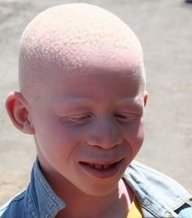

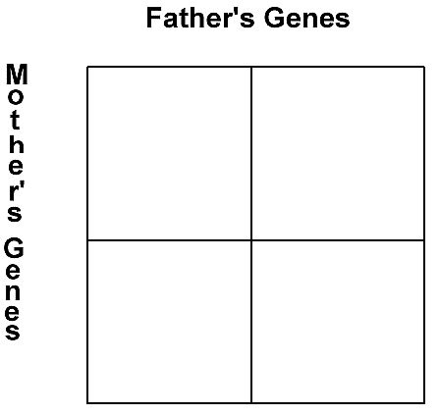
The allele for normal melanin (M) is dominant over the allele for albinism (m).
M
M
What is the probability of these parents having a child with albinism?
M
MM
MM
100% chance of normal melanin production
0% chance of albinism
m
Mm
Mm

Slide 21

Task: Read the Punnett Squares Walkthrough Worksheet uploaded onto Google classroom then answer the questions.
Extension questions
These questions are more challenging as you need to work out the genotype of the parents only from a written description.
1) In mice, white fur is dominant. What type of offspring would you expect from a cross between a heterozygous individual (has genes for white and brown fur) and one with homozygous with white fur? Explain your answer with a genetic diagram.
2) A homozygous long-tailed cat is crossed with a homozygous short-tailed cat and produces a litter of 9 long-tailed kittens. Show the probable offspring which would be produced if two of these kittens were mated and describe the characteristics of the offspring (hint: work out the kittens’ genotype first).

Slide 22
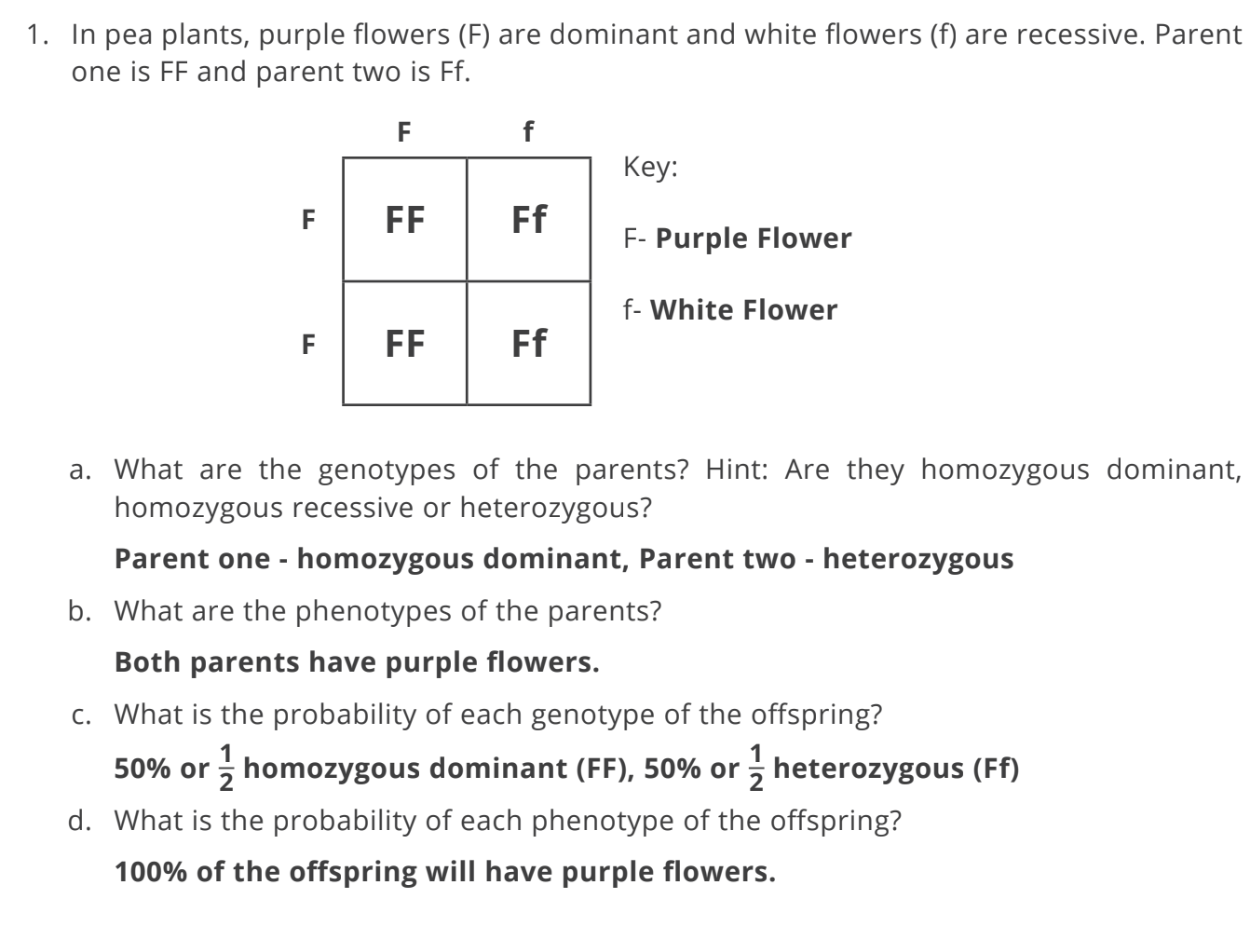


Slide 23
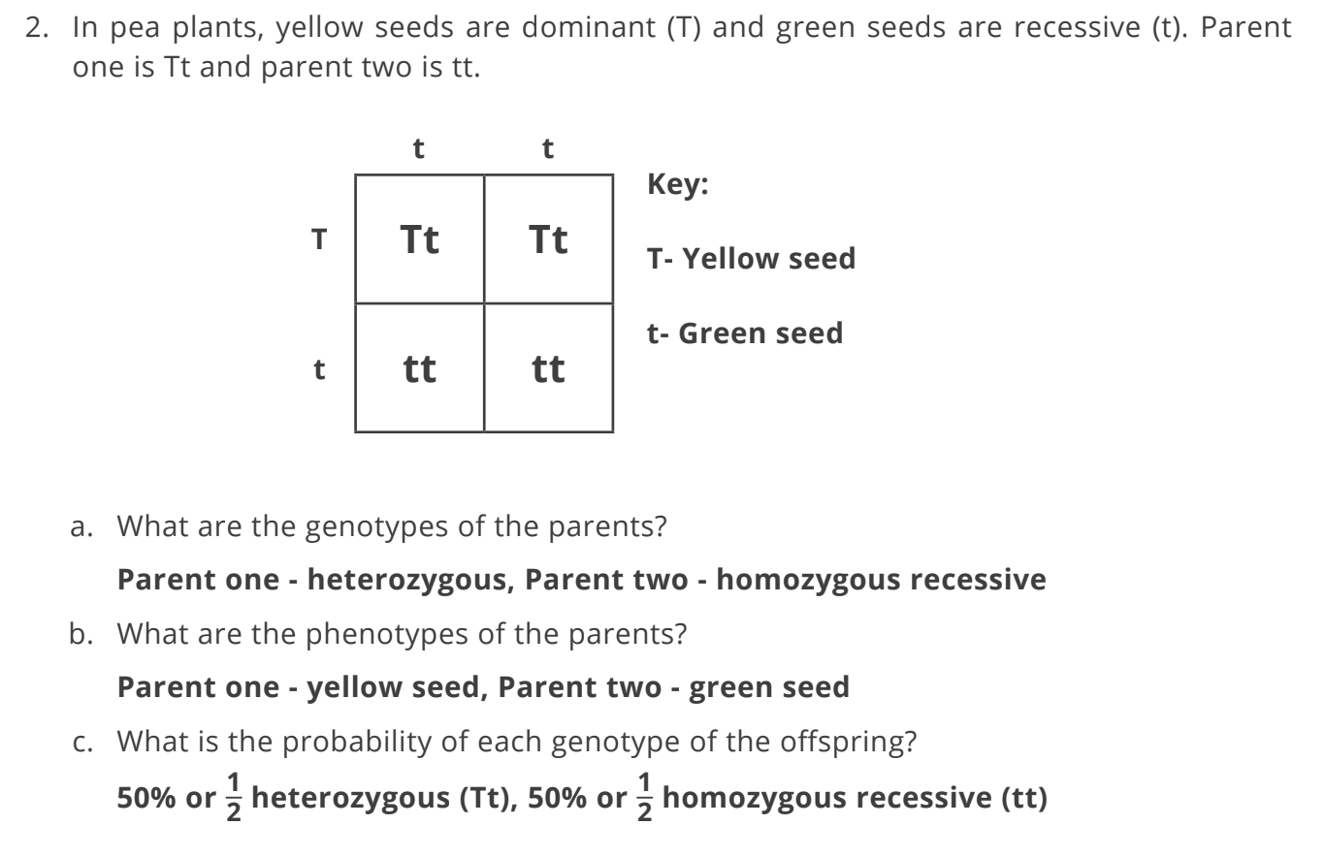

Slide 24
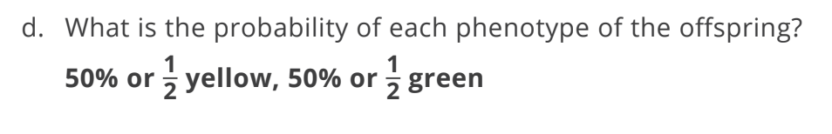

Slide 25
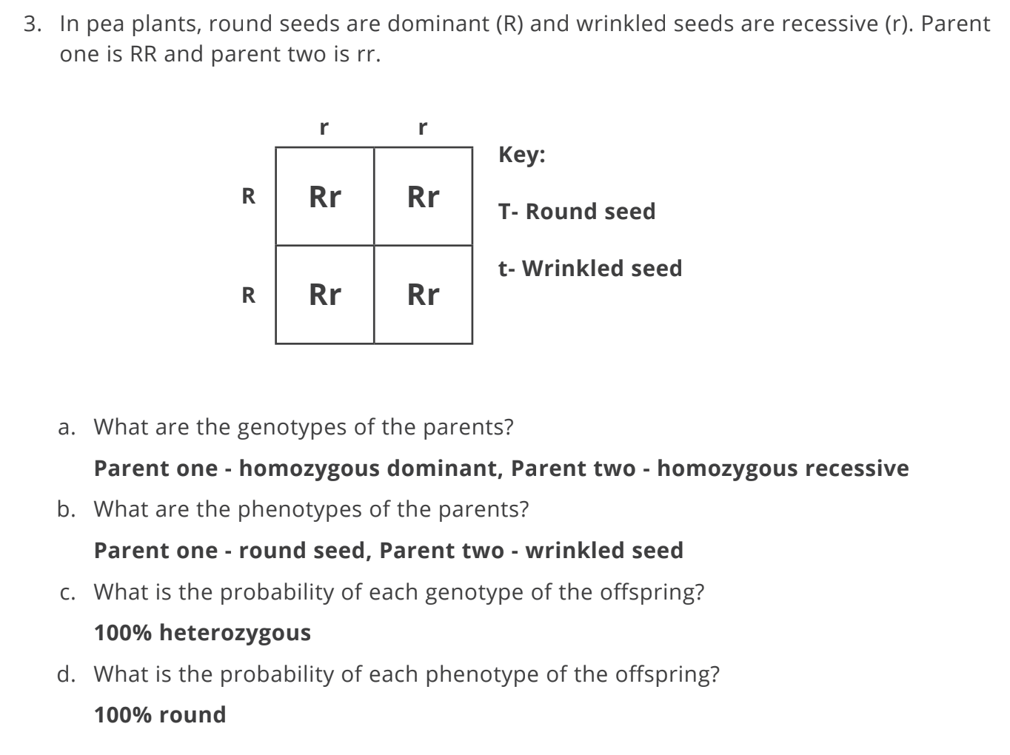

Slide 26
1) In mice, white fur is dominant. What type of offspring would you expect from a cross between a heterozygous individual (has genes for white and brown fur) and one with homozygous with white fur? Explain your answer with a genetic diagram.
W
w
W
WW
Ww
100% chance of white fur
0% chance of brown fur
W
WW
Ww

Slide 27
2) A homozygous long-tailed cat is crossed with a homozygous short-tailed cat and produces a litter of 9 long-tailed kittens. Show the probable offspring which would be produced if two of these kittens were mated and describe the characteristics of the offspring (hint: work out the kittens’ genotype first).
Cats
Kittens
L
L
L
l
l
Ll
Ll
L
LL
Ll
50% long tail
50% short tail
l
Ll
Ll
l
Ll
ll

Slide 28
Starter
Pair up and each pair get a mini whiteboard and tissue at the back of the room please!

Slide 29

Round 1:
Write down how inherited characteristics are passed from parents to offspring.
Notes:
Award 1 point to every team with genes, gametes, inherited in their answer.

Slide 30
Round 1:
Write down how inherited characteristics are passed from parents to offspring.
Inherited characteristics are passed from parents to offspring through genes contained in gametes (sex cells). During fertilisation, offspring inherit one set of genes from each parents
Notes:
Award 1 point to every team with genes, gametes, inherited in their answer.

Slide 31
Round 2:
Brown eyes (B) are dominant over blue (b). Genotype = Bb → eye colour?
2. Tongue rolling is dominant (R), both parents are Rr → what percentage of offspring can’t roll?
3. A trait disappears in one generation but reappears in the next - is it likely dominant or recessive?

Slide 32
Round 2:
Brown eyes (B) are dominant over blue (b). Genotype = Bb → eye colour?
2. Tongue rolling is dominant (R), both parents are Rr → what percentage of offspring can’t roll?
3. A trait disappears in one generation but reappears in the next - is it likely dominant or recessive?
Brown eyes
25%
Recessive

Slide 33
Round 3:
B - straight hair
b - curly hair
Bb × Bb
Draw the Punnett square correctly.
Write the genotype ratio.
Write the phenotype ratio.

Slide 34
Round 3:
Bb × Bb
Draw the Punnett square correctly.
Write the genotype ratio.
Write the phenotype ratio.
B - straight hair
b - curly hair
2. 1 BB : 2 Bb : 1 bb (1:2:1)
25% BB, 50% Bb, 25% bb
3. 3 straight hair : 1 curly hair
75% straight hair, 25% curly hair

Slide 35

‘What is a gene?’ summarised nicely!

